Slide 1
NSU ACM-W SC LEARNING BOOTCAMP 2020

Slide 2
ABOUT MY PROJECT
* It is an Online Wedding Invitation website.
* The website is built using HTML and CSS .
* On the website it shows
- Name of bride and groom
- A short message from bride and groom.
- The wedding venue, location, time & date
Some screen shots of my project are shown below:

Slide 3
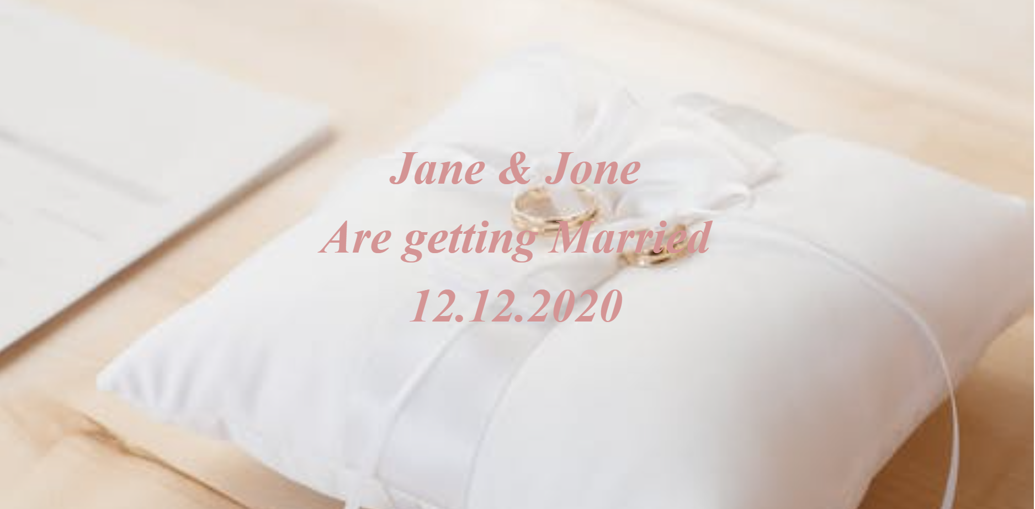
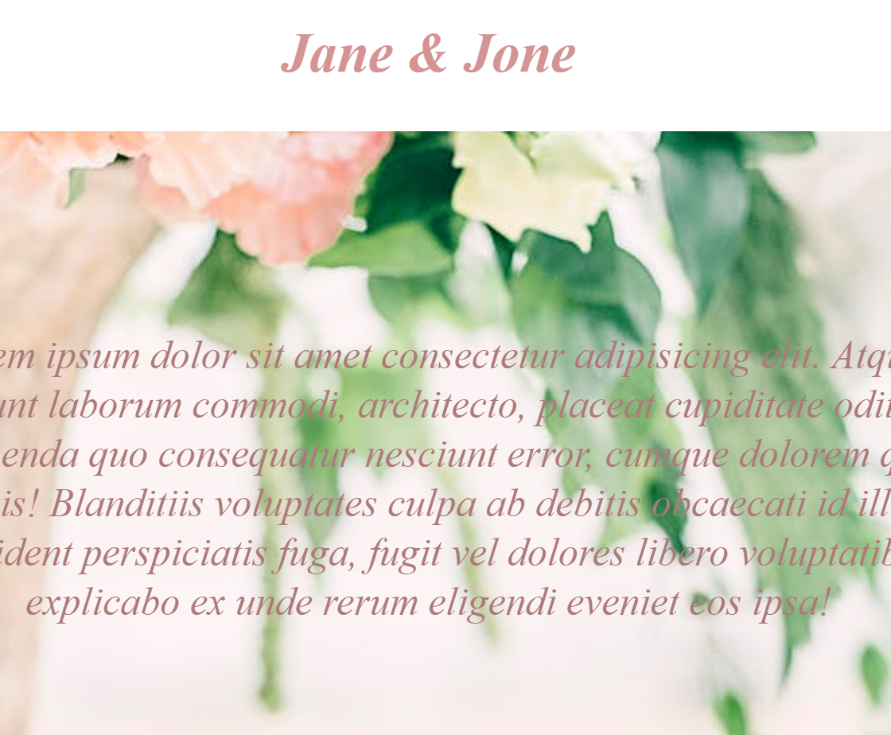
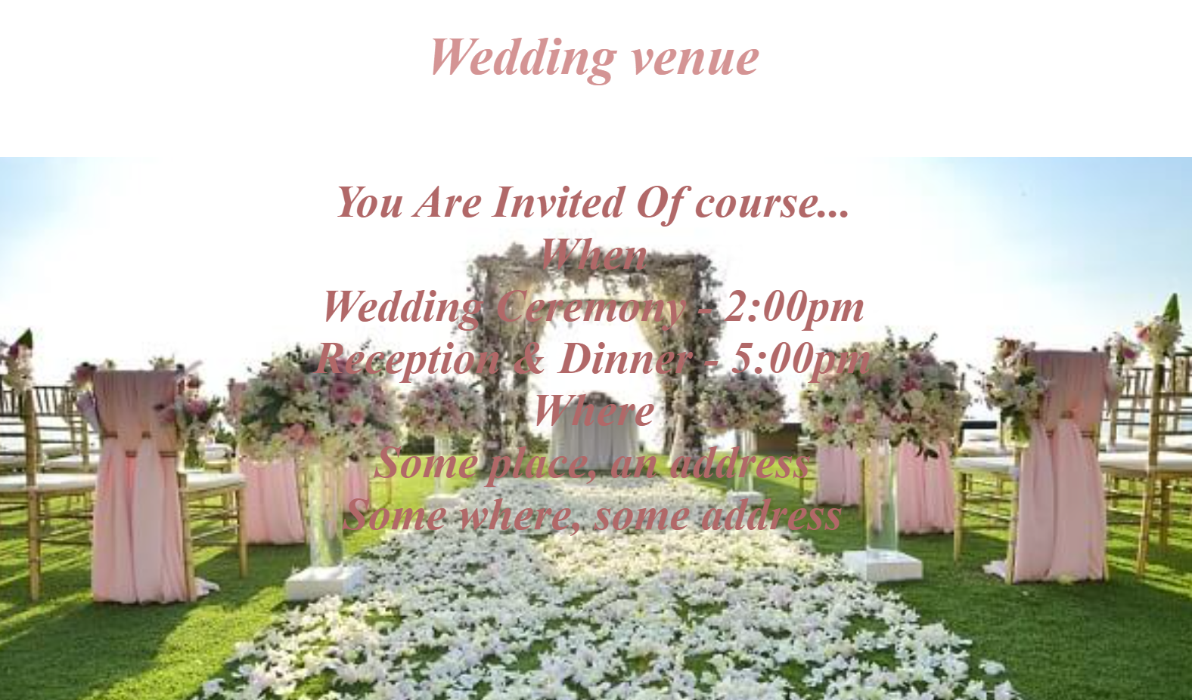

Slide 4
learnings from this event
* To use GitHub Desktop.
* Project, issue & milestone setup in GitHub.
* Kanban board setup.
* Framework.
* Bootstrap.

